Slide 1
Ethereum and Deep learning Main project supervisor: Roi Bar-Zur
Asala Ahmad
Hadeel Rayan
Date :19/03/2024

Slide 2


Slide 3
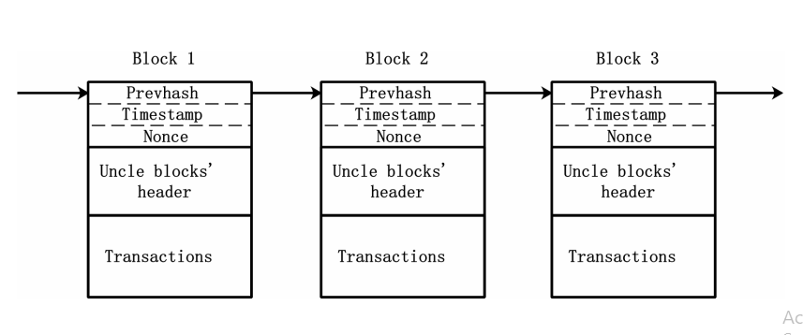
Definitions
Blockchain
Miners
Selfish mining
Bitcoin
Ethereum
MDP

Slide 4

What is MDP?
MDP: is to find an effective policy for the decision maker, an encompassing function Π that dictates the action Π(S) the decision maker will choose when in state S.
$S$ : is a set of states called the state space.
$A$ :is the set of actions, available from state S, called the action space.
$P_{a}\left(s,s^{′}\right)=\operatorname{Pr}\left(S_{t+1}=s \right| S_{t}=s , a_{t}=a)$: is the probability that action a in state $S$ at time t will lead to state ′$S^{′}$ at time t+1.
$R_{a}\left(S,S^{′}\right) :$ is the immediate reward (or expected immediate reward) received after transitioning from state S to state ′S’, due to action a.

Slide 5
OUR MDP

Slide 6
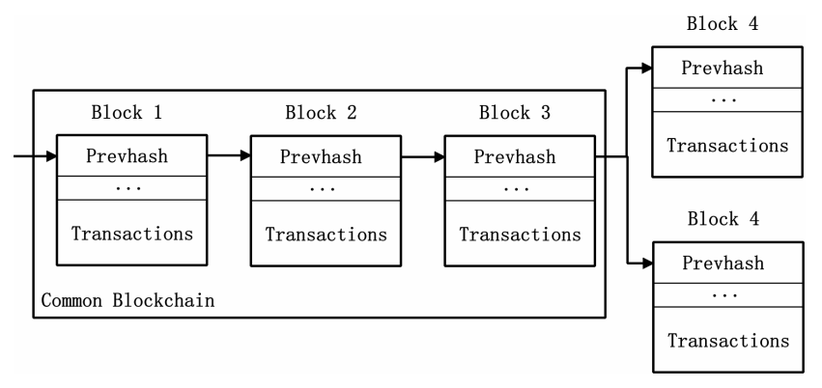
state space - S
a, h, length_a, length_h, transactions_a, transactions_h, fork, r, u_h, u_a, pool

Slide 7
Parameters and variables
Alpha
Gama
uncle_rewards
nephew_reward
Max fork
Max pool
difficulty contribution

Slide 8
Objective function
The attacker’s incentive is to maximize average revenue per unit of time, $\frac{\sum_{t=1}^{n}{R_{t}}}{\sum_{t=1}^{n}{D_{t}}}$ .

Slide 9
action space - A
Adopt
reveal
wait
match
Override

Slide 10
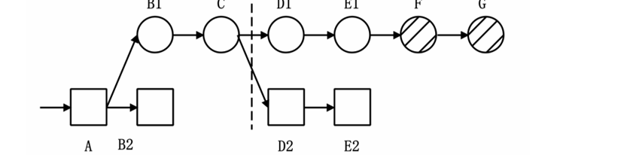

Adopt
represent the attacker’s acceptance of the first $l$ of the honest network’s chain
the $l$ blocks in the attacker’s current chain are now can be used as uncles.

Slide 11

reveal :If length-$a$ > 0 and length-$h>1$ the miner may reveal the first block of his private chain to be included as an uncle , unless it was already revealed

Slide 12

Override
represent the publication of the first $l$ of the attacker’s blocks, feasible if length-$a>length−h$

Slide 13
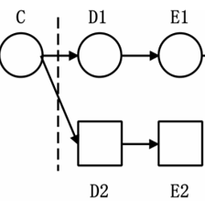
match
represents the case where the most recent block was built by the honest network, and the attacker now publishes a conflicting block of the same height.

Slide 14
wait
implies that the attacker does not publish new blocks, but keep working on its branch until a new block is built
Tere are Two different cases : fark= relevant or Fork=active

Slide 15
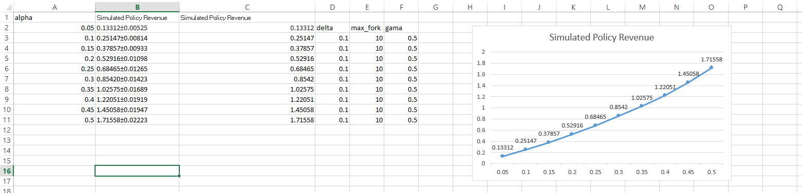
RESULTS:

Slide 16
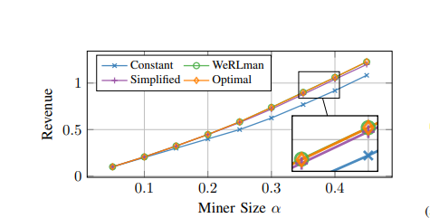
Previse results:
(Without fees)
Source :WeRLman: To Tackle Whale (Transactions), Go Deep (RL)

Slide 17
Challenges :
Memory problems
Long run time

Slide 18
Previous work:
Efficient MDP Analysis for Selfish-Mining in Blockchains
WeRLman: To Tackle Whale (Transactions), Go Deep (RL)
Majority is not Enough: Bitcoin Mining is Vulnerable
Optimal Selfish Mining Strategies in Bitcoin

